Slide 1
NYCU DLP
Lab5 - Let’s Play GANs
2021 Summer
李美慧
August 5, 2021

Slide 2
Outline
Lab Objective
Important Date
Lab Description
Scoring Criteria

Slide 3
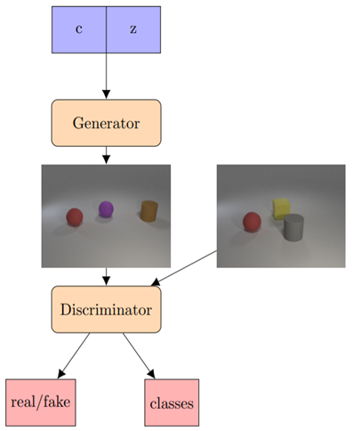
Lab Objective
In this lab, you need to implement a conditional GAN and generate synthetic images based on multi-labels conditions
Example of labels:
[“cyan cylinder”, “red cube”], [“green sphere”], …

Slide 4
Important Date
Report Submission Deadline: 8/24 (Tue.) 11:55 a.m.
Demo date: 8/24 (Tue.)
Zip all files into one file
Report (.pdf)
Source code
Name it like「DLP_LAB5_yourstudentID_name.zip」
Ex: 「DLP_LAB5_309551027_李美慧.zip」

Slide 5
Lab Description
Choose your conditional GAN architecture
Design your generator and discriminator
Choose your loss function
Use a pretrained classifier to evaluate accuracy

Slide 6
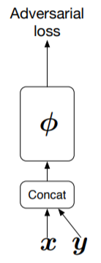
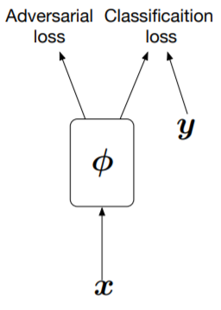
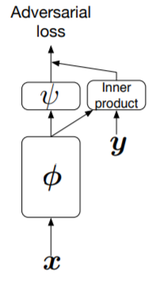
Lab Description – Choice of cGAN
Generator
Concatenation, multiplication, batch normalization, etc.
Similar technique used in cVAE
Discriminator
Conditional GAN
InfoGAN
Auxiliary GAN
Projection discriminator
Hybrid version
(Conditional GAN)
(AC GAN)
(Projection discriminator)

Slide 7
Lab Description – Design of GAN
De-convolution layers
Basic block
Bottleneck block
Residual
Self-attention
Again, hybrid version
E.g.
DCGAN
SA-GAN
Progressive GANA

Slide 8

Lab Description – Choice of loss functions
GAN loss function
LSGAN
WGAN
WGAN-GP
Combine with your choice of cGAN

Slide 9
Lab Description – Pretrained Classifier
We provided a pre-trained ResNet-18 & evaluation model. You need to use eval(images, labels) to compute accuracy of your synthetic images
Labels should be one-hot vector. E.g. [[1,1,0,0,…],[0,1,0,0,…],…]
Images should be all generated images. E.g. (batch size, 3, 64, 64)
Use make_grid(images) and save_image(images, path) (from torchvision.utils import save_image, make_grid) to save your image (8 images a row, 4 rows)

Slide 10
Lab Description – Other details
You can use any GAN architecture your like
The resolution of input for pretrained classifier is 64x64. You can design your own output resolution for generator and resize it.
You cannot use other training data except for the provided files (for example: background images)

Slide 11
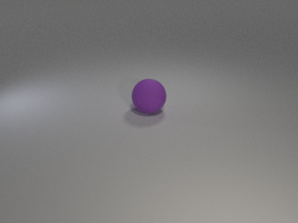
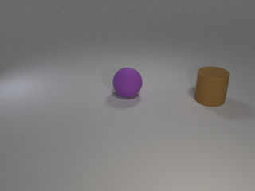
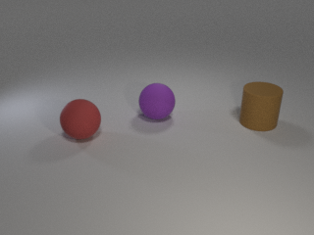
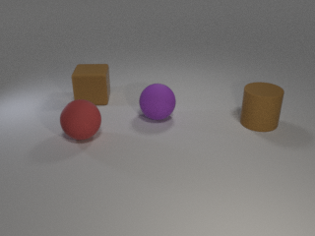
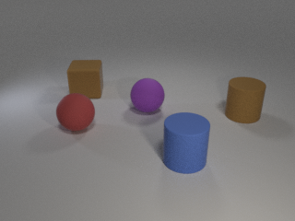
Lab Description - Dataset
Provided files
readme.txt, train.json, test.json, object.json, evaluator.py, dataset.py, classifier_weight.pth, images folder
object.json
Dictionary of objects
24 classes: cyan cylinder, red cube, green sphere…
Same object will not appear twice in an image

Slide 12
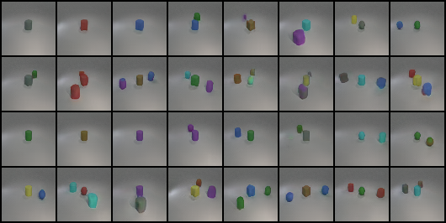
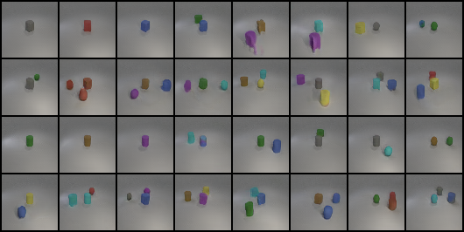
Lab Description – Output examples
Accuracy: 0.667
Accuracy:0.847

Slide 13
Lab Description – Requirements
Implement training, testing functions, and dataloader
Choose your cGAN architecture
Design your generator and discriminator
Choose your loss functions
Output the results based on test.json and new_test.json (will be released before demo)

Slide 14
Scoring Criteria – Report(40%)
Introduction (5%)
Implementation details (15%)
Describe how you implement your model, including your choice of cGAN, model architectures, and loss functions. (10%)
Specify the hyperparameters (learning rate, epochs, etc.) (5%)
Results and discussion (20%)
Show your results based on the testing data. (5%)
Discuss the results of different models architectures. (15%) For example, what is the effect with or without some specific loss terms, or what kinds of condition design is more effective to help cGAN

Slide 15
Scoring Criteria – Demo(60%)
Classification accuracy on test.json and new_test.json. (20% + 20%)
score >= 0.8 ---- 100%
0.8 > score >= 0.7 ---- 90%
0.7 > score >= 0.6 ---- 80%
0.6 > score >= 0.5 ---- 70 %
0.5 > score >= 0.4 ---- 60 %
score < 0.4 ---- 0%
Questions (20%)

